Slide 1

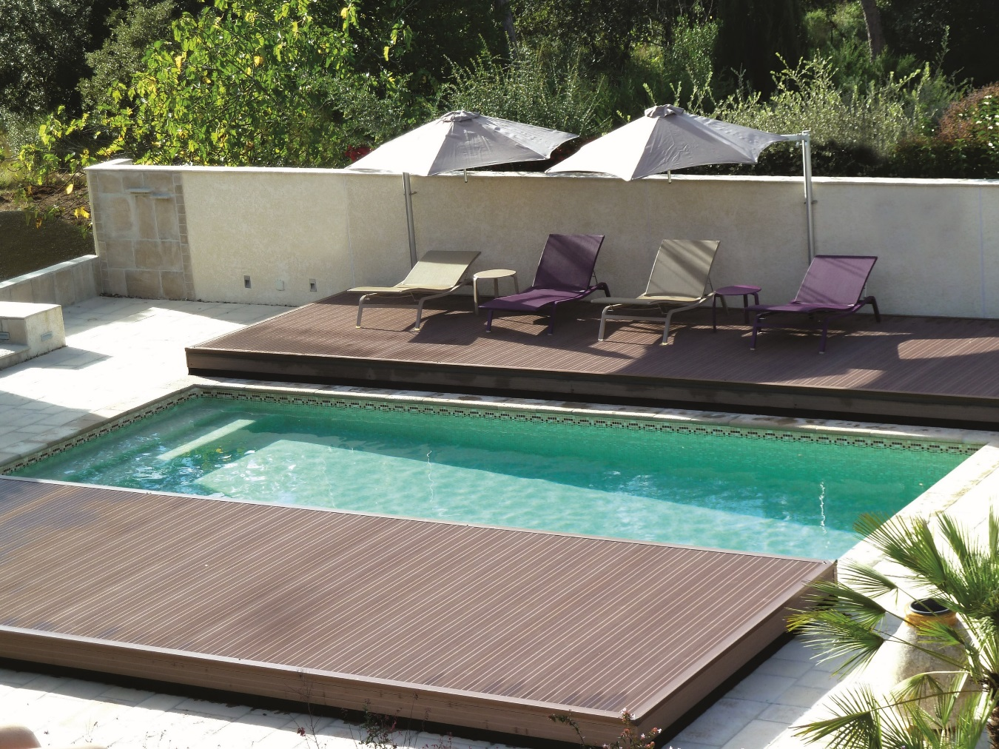

ASSEMBLY INSTRUCTIONS
POOLDECK

Slide 2
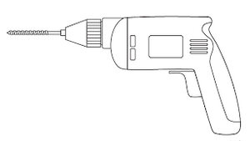
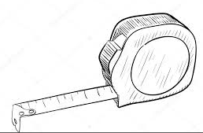
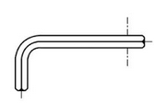

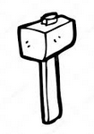
FOREWORD
We congratulate you on the purchase of your Pooldeck pool enclosure.
This enclosure has been designed to ensure that you are fully satisfied, both when assembling it and when using it.
To ensure that you are fully satisfied, we recommend that you read and follow the assembly instructions carefully:
- These diagrams are established as examples and in no way replace official documents such as standards, professional recommendations, codes of practice, industry practices, etc.
- It is the responsibility of the person installing the enclosure to ensure that these standards are met;
we will not be held responsible for any incorrect installation or technical misuse of our products,
- Any modifications, even partial, involving a product that is not from
"AZENCO GROUP" shall exempt the latter from any civil, criminal, financial and legal liability.
Avoid assembling your enclosure in wet or windy conditions.
- Do not install your enclosure directly under a power line.
- Avoid placing tools on the upper parts of the enclosure when assembling it.
- You must also ensure that children are kept away from the enclosure during assembly to avoid the risk of them falling from a ladder, being injured by sharp tools, etc.
- Even if you do not plan to assemble your enclosure immediately after purchase, we recommend that you take the time to unpack the enclosure, check that all parts are present (using the parts list) and that none of them are damaged or broken. If you find that a part is missing or damaged, or if you encounter any problems when assembling your enclosure, please contact our after-sales team. They will deal with your request as soon as possible.
Please keep all documents concerning your enclosure (instructions, invoice, etc.) for future reference; you will need them if you contact us at a later date.
EQUIPMENT REQUIRED (not supplied)
Drill Tape measure Allen key
12mm and 6mm concrete drill bits Mallet/Hammer

Slide 3
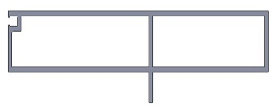
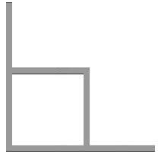
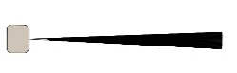
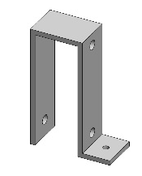
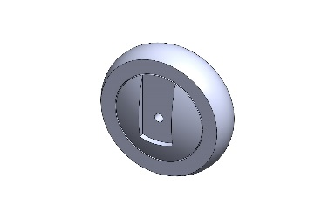
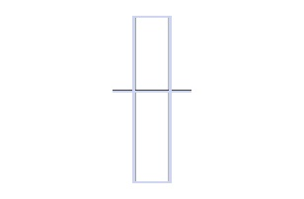
2
ASSEMBLY - PARTS LIST
PART N° | DESCRIPTION |  | QTY
1 | BEAM |  | X
2 | CONNECTING BRACKET |  | X
3 | BRUSH SEAL - SWJ055 |  | X
4 | WHEEL SUPPORT BRACKET |  | X
6 | WHEEL |  | X
7 | AP14 beam |  | X

Slide 4
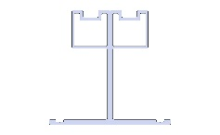
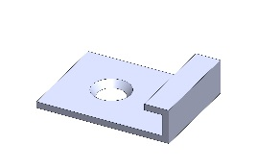
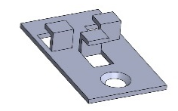
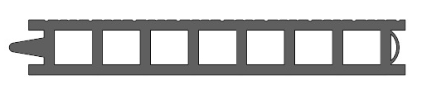
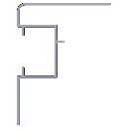
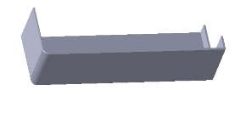
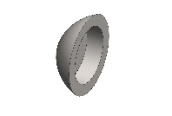
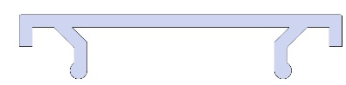
2
ASSEMBLY - PARTS LIST
PART N° | DESCRIPTION |  | QTY
8 | I-SHAPED CROSS BEAM |  | X
9 | STARTER CLIP |  | X
10 | JOINING CLIP |  | X
11 | FLOOR SLAT |  | X
12 | ALUMINIUM EDGING STRIP |  | X
13 | CORNER PIECE |  | X
14 | SCREW COVER - SWQ262 |  | X
15 | CLIPS |  | X

Slide 5
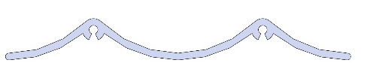
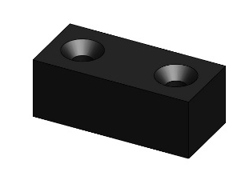
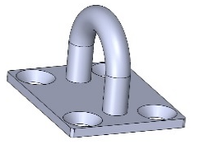
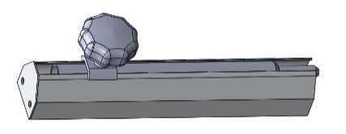
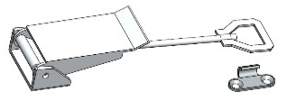
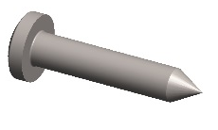
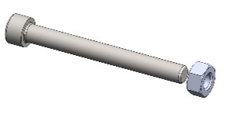
2
ASSEMBLY - PARTS LIST
PART N° | DESCRIPTION |  | QTY
16 | GUIDE |  | X
17 | STOP BLOCK - SWQ20 |  | X
18 | LOCKING HOOK |  | X
19 | VERINOX DROP PIN |  | X
20 | SWQ7055 |  | X
21 | SCREW (4.8 x 25) |  | X
22 | BOLT (M8 x 75) + NUT |  | X

Slide 6
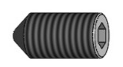
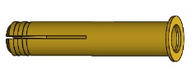
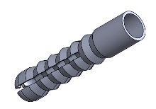
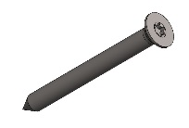
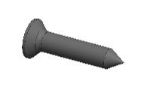
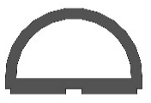
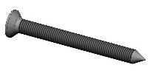
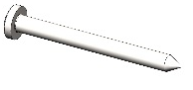
2
ASSEMBLY - PARTS LIST
PART N° | DESCRIPTION |  | QTY
23 | SET SCREW (M10 x 20mm) |  | X
24 | SCREW PLUG (M10 x 60mm) |  | X
25 | SCREW PLUG (M6 x 60mm) |  | X
26 | SCREW (5 x 50) |  | X
27 | COUNTERSUNK SELF-DRILLING SCREW (3.9 x 19) |  | X
28 | DECK SEAL 02 |  | X
29 | COUNTERSUNK SELF-DRILLING SCREW (4.8 x 50) |  | X
30 | ROUND-HEAD SELF-DRILLING SCREW (4.8 x 50) |  | X

Slide 7
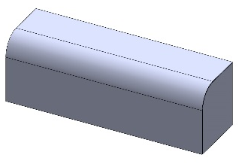
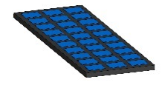
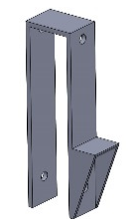
2
ASSEMBLY - PARTS LIST
PART N° | DESCRIPTION |  | QTY
31 | MOTOR |  | X
32 | SOLAR PANEL |  | X
33 | SEAL - SWJ010001 |  | X
34 | WHEEL SUPPORT BRACKET #2 |  | X

Slide 8
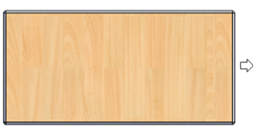
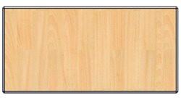
ASSEMBLY – POOLDECK
STEP 1 Place the Pooldeck beams that will not be fitted with wheels on the trestles
OPTION 1: The Pooldeck travels lengthways, so the wheels should be positioned on the longest beams
OPTION 2: The Pooldeck travels widthways, so the wheels should be positioned on the shorter beams
If your Pooldeck is longer than 5m, the beams are slightly curved

Slide 9
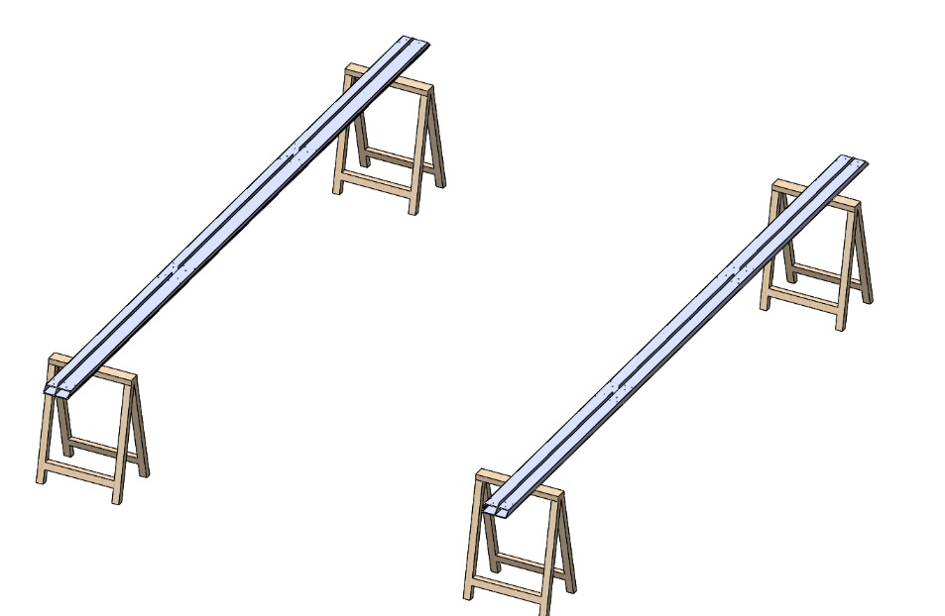
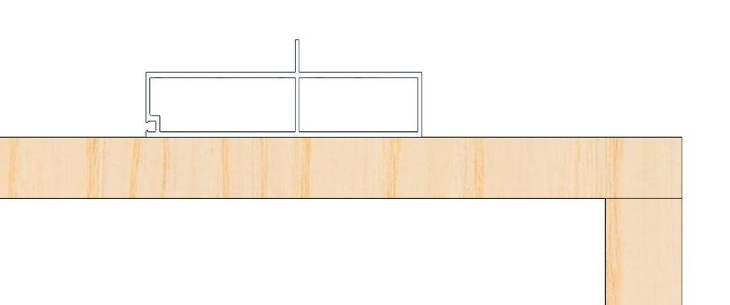
ASSEMBLY – POOLDECK
Beam
A
Beam
B

Slide 10
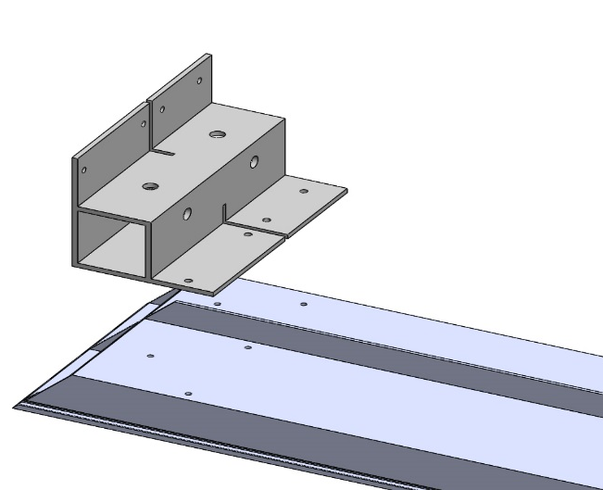
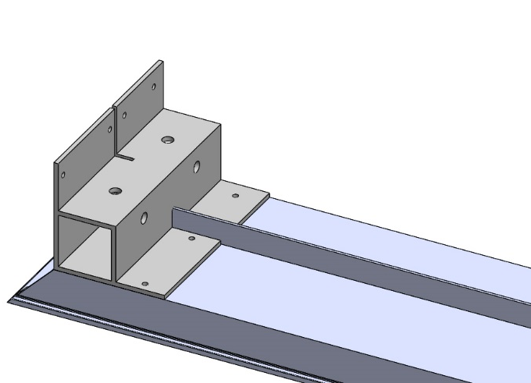
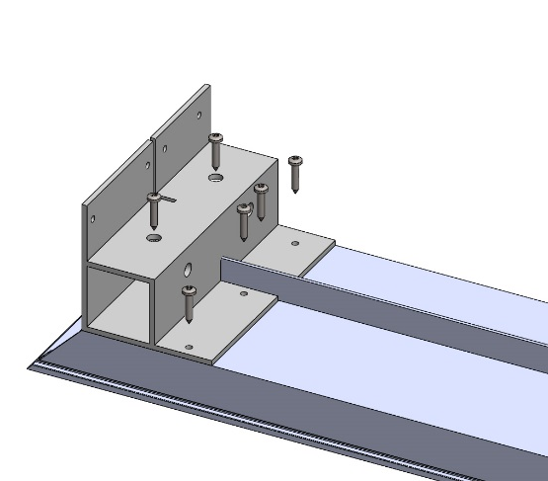
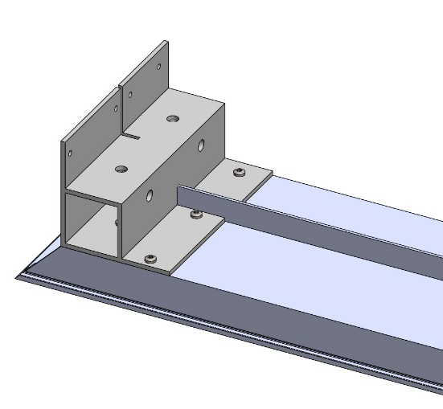
ASSEMBLY – POOLDECK
STEP 2
Position the connecting brackets on the ends of the beams
STEP 3
Screw in place with the 4.8x25 screws
Connecting bracket
Beam
A
B
Screw (4.8x25)
A
B

Slide 11
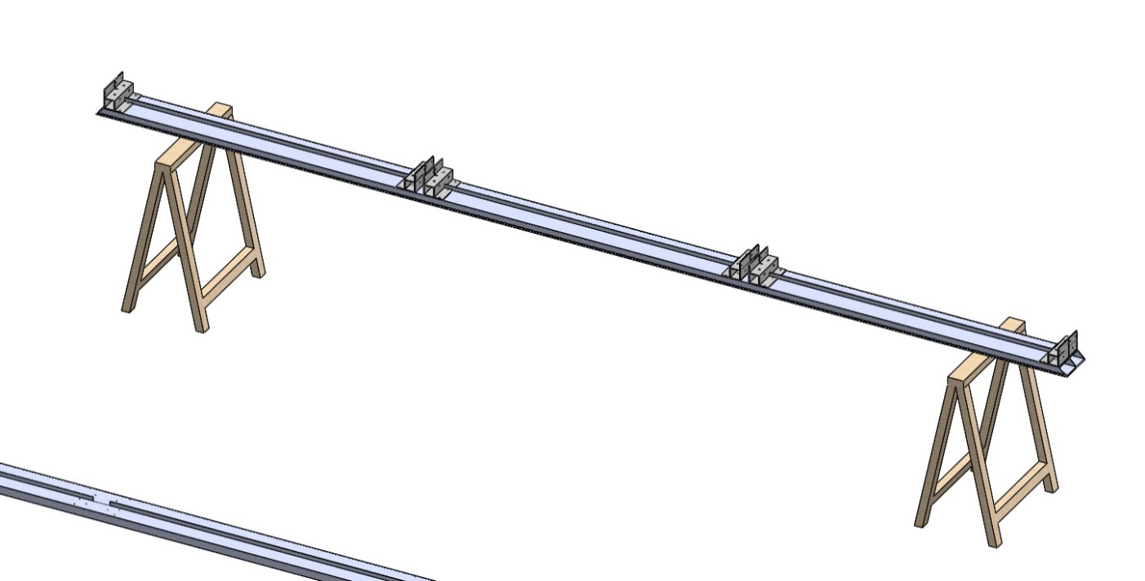
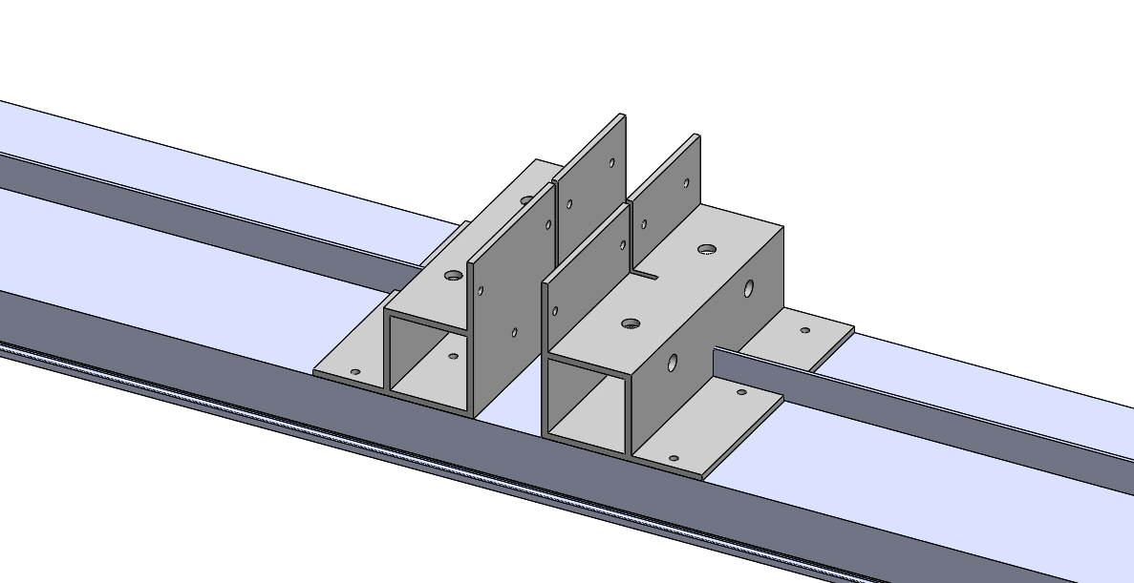
ASSEMBLY – POOLDECK
STEP 4
Repeat steps 2 and 3 as shown below:

Slide 12
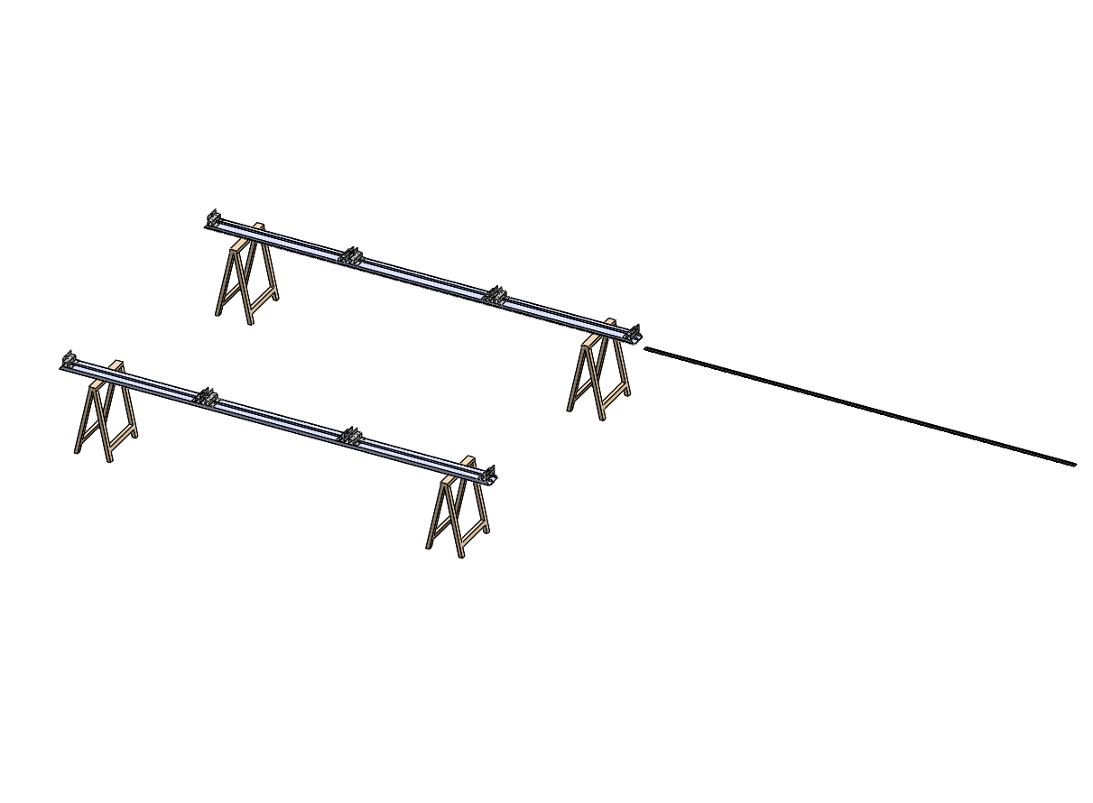
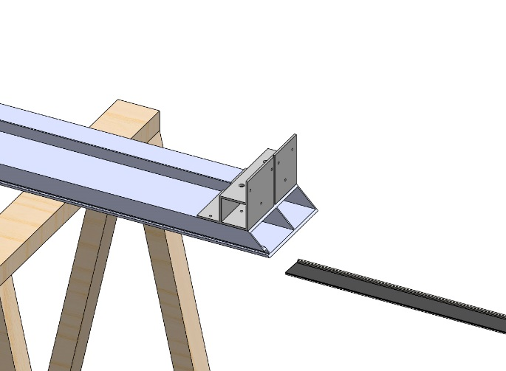
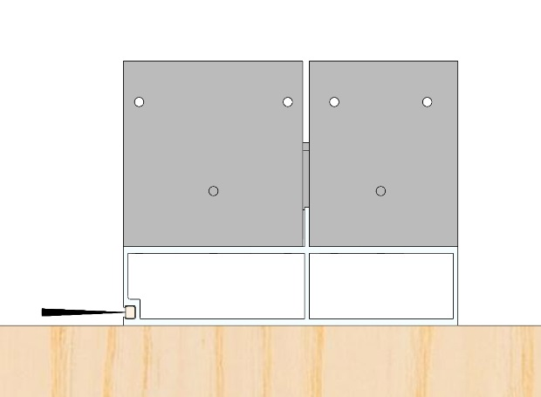
ASSEMBLY – POOLDECK
STEP 5
Position the brush seal - SWJ055
Beam
SWJ055
If the deck height is 100, you will need to substitute the SWJ010001 seal for the SWJ055 brush seal
Connecting bracket
SWJ055
Beam
SWJ055
A
B

Slide 13



ASSEMBLY – POOLDECK
C
D
E

Slide 14

ASSEMBLY – POOLDECK
F

Slide 15

ASSEMBLY – POOLDECK
STEP 6
Place the remaining 2 beams (which are to be fitted with wheels) on trestles

Slide 16


ASSEMBLY – POOLDECK
STEP 7
Position the wheel support bracket + wheel at the end of the beam
Beam
Wheel support bracket
wheel
A
B
If the deck height is 100, use the wheel support bracket #2 (see parts list)

Slide 17


ASSEMBLY – POOLDECK
STEP 8
Fix the wheel support + wheel to the beam using the 8x75 bolts
Bolt (8x75)
A
B

Slide 18


ASSEMBLY – POOLDECK
Nut
C
D

Slide 19

ASSEMBLY – POOLDECK
STEP 8
Screw the wheel support to the beam using the 4.8x25 screws
Screw (4.8x25)

Slide 20

ASSEMBLY – POOLDECK
STEP 9
Repeat on the other side

Slide 21


ASSEMBLY – POOLDECK
STEP 10
Slide the SWJ055 seal into the beams
SWJ055
A
Brush (50)
B

Slide 22


ASSEMBLY – POOLDECK
C
D

Slide 23

ASSEMBLY – POOLDECK
D

Slide 24


ASSEMBLY – POOLDECK
STEP 11
Position the first beam (from step 1) on the ground
STEP 12
Position the AP14 beams
A
Beam
AP14 beam
A

Slide 25


ASSEMBLY – POOLDECK
B
C

Slide 26


ASSEMBLY – POOLDECK
STEP 13
Screw in place using the 4.8x25 screws
Screw (4.8x25)
A
B

Slide 27


ASSEMBLY – POOLDECK
C
STEP 14
Attach the second beam to the AP14 beam

Slide 28


ASSEMBLY – POOLDECK
STEP 15
Add the first beam (fitted with wheels in step 6)
Beam
with wheels
A
Beam
without wheels
Beam
with wheels
B

Slide 29


ASSEMBLY – POOLDECK
C
D

Slide 30


ASSEMBLY – POOLDECK
STEP 16
Screw in place using the 4.8x25 screws
Screw (4.8x25)
A
B

Slide 31

ASSEMBLY – POOLDECK
STEP 17
Repeat on the other side

Slide 32


ASSEMBLY – POOLDECK
STEP 18
Position the I-shaped cross beam between the beam and the AP14 beams
I-SHAPED CROSS BEAM
Beam
AP14 beam
A
B

Slide 33


ASSEMBLY – POOLDECK
C
Pre-drilled
hole
I-SHAPED CROSS BEAM
D

Slide 34


ASSEMBLY – POOLDECK
STEP 19
Screw the I-shaped cross beam in place with the 4.8x25 screws
Screw (4.8x25)
A
B

Slide 35


ASSEMBLY – POOLDECK
C
D

Slide 36


ASSEMBLY – POOLDECK
E
STEP 20
Repeat for the other cross beams

Slide 37


ASSEMBLY – POOLDECK
If the length of your Pooldeck is less than 5m, skip to step 21

Slide 38



ASSEMBLY – POOLDECK
STEP 20.1
Position the 4 reinforcement plates 30 cm from the edge of the Pooldeck
The reinforcement plates are to be positioned on the two shorter sides of the Pooldeck
30cm

Slide 39


ASSEMBLY – POOLDECK
STEP 20.2 Drill the holes as shown below:
To make things easier, we have assigned a letter to each hole:
Ø 4 mm
Ø 4 mm
Ø 22 mm
Ø 4 mm
C
D
A
B

Slide 40


ASSEMBLY – POOLDECK
STEP 20.3 Screw the reinforcement plate to the Pooldeck beam using the 4.8 x 25 round-head self-drilling screws at holes B / C and D
4.8x25 screws

Slide 41


ASSEMBLY – POOLDECK
STEP 20.4
Slide the male tie rod through hole A in the reinforcement plate

Slide 42


ASSEMBLY – POOLDECK
STEP 20.5
Slide the female tie rod through hole A in the reinforcement plate (reverse side)

Slide 43



ASSEMBLY – POOLDECK

Slide 44


ASSEMBLY – POOLDECK
STEP 20.6
Attach the two tie rods using a Ø14mm bolt, 2 x Ø30mm washers and a lock nut
Lock nut
Ø30mm washer
Ø14mm bolt
Ø30mm washer

Slide 45


ASSEMBLY – POOLDECK
STEP 20.7
Attach the two tie rods to the reinforcement plates using a Ø40mm washer and a Ø22mm bolt
Reinforcement
plate
Tie rod
Ø40mm washer
Ø22 bolt

Slide 46


ASSEMBLY – POOLDECK
STEP 20.8 Repeat on each side

Slide 47


ASSEMBLY – POOLDECK
STEP 20.9 Cut the tie rod flush with the bolt

Slide 48

ASSEMBLY – POOLDECK
STEP 21
Measure 10mm around the edge all around of the Pooldeck

Slide 49

ASSEMBLY – POOLDECK
10mm
10mm

Slide 50


ASSEMBLY – POOLDECK
STEP 22
Position the starter clip at the corner of the Pooldeck (on the line that you marked 10 mm from the edge in step 21)
Starter clip
A
B

Slide 51


ASSEMBLY – POOLDECK
STEP 23
Screw in place with a 3.9x19 countersunk self-drilling screw
Countersunk self-drilling screw (3.9x19)
A
B

Slide 52

ASSEMBLY – POOLDECK
STEP 24
Repeat this opposite each I-shaped cross beam and at the remaining corner

Slide 53

ASSEMBLY – POOLDECK
Starter
clip

Slide 54


ASSEMBLY – POOLDECK
STEP 25
Position the first floor slat
Floor slat
A

Slide 55


ASSEMBLY – POOLDECK
B
STEP 26
Position the next joining clips against the floor slat, respecting the 10mm gap around the edge
Starter
clip
A

Slide 56


ASSEMBLY – POOLDECK
B
STEP 27
Screw in place with a 3.9x19 countersunk self-drilling screw
Countersunk self-drilling screw (3.9x19)
A

Slide 57


ASSEMBLY – POOLDECK
B
STEP 28
Place the joining clip on the I-shaped cross beam
Joining
clip
A

Slide 58


ASSEMBLY – POOLDECK
B
C

Slide 59


ASSEMBLY – POOLDECK
STEP 29
Screw in place with a 3.9x19 countersunk self-drilling screw
Screw (3.9x19)
COUNTERSUNK
SELF-DRILLING
SCREW
A
B

Slide 60

ASSEMBLY – POOLDECK
STEP 30
Repeat for all of the cross beams
Floor slat
Starter clip

Slide 61


ASSEMBLY – POOLDECK
STEP 31
Position the next floor slat
Floor slat 1
Floor slat 2

Slide 62


ASSEMBLY – POOLDECK
STEP 32
Repeat steps 26 to 31 until the entire surface of the Pooldeck is covered
FOR THE LAST SLAT
Position the last floor slat

Slide 63


ASSEMBLY – POOLDECK
Draw a line for cutting the slat to the required size - keeping the 10mm gap at the edge
Cut the slat and re-position it
10mm

Slide 64



ASSEMBLY – POOLDECK
Screw in place with a 3.9x19 countersunk self-drilling screw
Countersunk self-drilling screw (3.9x19)

Slide 65


ASSEMBLY – POOLDECK
STEP 33
Position the starter clips on the beam 5cm from the edge
Starter clip
5cm
A
B

Slide 66


ASSEMBLY – POOLDECK
STEP 34
Screw in place with a 3.9x19 countersunk self-drilling screw
Countersunk self-drilling
screw (3.9x19)
A
B

Slide 67

ASSEMBLY – POOLDECK
STEP 35
Repeat every 50cm
50cm

Slide 68


ASSEMBLY – POOLDECK
STEP 36
Position the floor slat on the starter clips
Floor slat
Starter clip

Slide 69


ASSEMBLY – POOLDECK

Slide 70


ASSEMBLY – POOLDECK
STEP 36.1
If your Pooldeck is longer than 5m, cut out a section of the floor slat to make room for the bolt:

Slide 71


ASSEMBLY – POOLDECK

Slide 72


ASSEMBLY – POOLDECK
STEP 37
Fix the floor slat to the beam using a 3.9x19 countersunk screw every 50cm
Countersunk
self-drilling screw (3.9x19)

Slide 73


ASSEMBLY – POOLDECK

Slide 74

ASSEMBLY – POOLDECK
50cm
50cm
50cm

Slide 75

ASSEMBLY – POOLDECK
STEP 38
Repeat steps 33 to 37 all around the Pooldeck

Slide 76



ASSEMBLY – POOLDECK
STEP 39
Position the aluminium edging strip as shown below
Aluminium edging strip
A
B
C

Slide 77


ASSEMBLY – POOLDECK
STEP 40
Drill a Ø4mm hole 5cm from the edge
4mm drill bit
A
B

Slide 78


ASSEMBLY – POOLDECK
C
D

Slide 79


ASSEMBLY – POOLDECK
STEP 41
Screw in place with 4.8x25 screws
Screw (4.8x25)
A
B

Slide 80

ASSEMBLY – POOLDECK
C

Slide 81


ASSEMBLY – POOLDECK
STEP 42
Repeat every 50cm
50cm
STEP 43
Repeat steps 39 to 42 all around the Pooldeck
Aluminium edging strip

Slide 82


ASSEMBLY – POOLDECK
Aluminium edging strip
Aluminium
edging strip

Slide 83

ASSEMBLY – POOLDECK
Aluminium
edging strip

Slide 84


ASSEMBLY – POOLDECK
STEP 44
Position the corner piece at the corner of the Pooldeck
Corner piece
A
B

Slide 85



ASSEMBLY – POOLDECK
STEP 45
Drill a Ø 4mm hole in the centre of the edging strip and the corner piece
4mm drill bit
A
B

Slide 86



ASSEMBLY – POOLDECK
STEP 46
Repeat on the second side of the corner piece
A
B
C

Slide 87


ASSEMBLY – POOLDECK
STEP 47
Screw the corner piece in place using the 4.8x50 screws
Screw (4.8x50)
A
B

Slide 88


ASSEMBLY – POOLDECK
STEP 48
Fit the SWQ262 screw covers
SWQ262
A
B

Slide 89

ASSEMBLY – POOLDECK
STEP 49
Repeat steps 44 to 48 on all 4 corners of your Pooldeck

Slide 90




ASSEMBLY – POOLDECK
STEP 50
Position the clips on the aluminium edging strip
Aluminium edge profile
Clips
A
B
Clips
C
D

Slide 91





ASSEMBLY – POOLDECK
STEP 51
Pre-drill the guide rail to Ø 5mm at 5cm from the edge and drill a hole every 50cm
5mm drill bit
5cm
50cm
Rail
B
50cm
C
50cm
D
A

Slide 92




ASSEMBLY – POOLDECK
STEP 52
Drill Ø 10mm holes in the guide rail
10mm drill bit
Rail
A
B
C
D

Slide 93


ASSEMBLY – POOLDECK
E
STEP 53
Position the guide rail on the ground

Slide 94


ASSEMBLY – POOLDECK

Slide 95


ASSEMBLY – POOLDECK
STEP 54
Drill a Ø 6mm hole in the ground
6mm drill bit

Slide 96


ASSEMBLY – POOLDECK
STEP 55
Using a hammer, fix the rail to the ground using the screw plugs and 4.8x50 screws
Screw (4.8x50)
Screw plug

Slide 97

ASSEMBLY – POOLDECK

Slide 98


ASSEMBLY – POOLDECK
STEP 56
Position the SWQ20 stop block at both ends of the rail, as close as possible to the wheel
SWQ20

Slide 99



ASSEMBLY – POOLDECK
STEP 57
Measure
STEP 58
Move the Pooldeck and re-position the stop block to the correct distance, and pre-drill the rail to Ø 4mm
4mm drill bit

Slide 100


ASSEMBLY – POOLDECK
STEP 59
Fix in place with screw plugs and 5x50 screws
Screw (5x50)
Screw plug

Slide 101


ASSEMBLY – POOLDECK
STEP 60
Move the Pooldeck and repeat this process at the other end of the rail

Slide 102


ASSEMBLY – POOLDECK
SWQ20

Slide 103

ASSEMBLY – POOLDECK

Slide 104


ASSEMBLY – POOLDECK
STEP 61
Position the locking hook 5cm from the edge
Locking hook

Slide 105


ASSEMBLY – POOLDECK
STEP 62
Drill 4 holes of the hook to Ø 4mm
4mm
drill bit

Slide 106


ASSEMBLY – POOLDECK

Slide 107


ASSEMBLY – POOLDECK
STEP 63
Screw in place with the 4.8x25 screws
Screw
(4.8x25)

Slide 108

ASSEMBLY – POOLDECK
STEP 64
Repeat on the other side
USE THE HANDLING POLE TO MOVE THE POOLDECK

Slide 109


ASSEMBLY – POOLDECK
STEP 65
Position the Verinox drop pin support 25 cm from the edge
Verinox
drop pin support
25cm

Slide 110



ASSEMBLY – POOLDECK
STEP 66
Using a 4mm drill bit, drill a hole through the Verinox drop pin support & the Pooldeck frame
STEP 67
Screw in place with the 4.8x50 screws
4mm drill bit

Slide 111




ASSEMBLY – POOLDECK
STEP 68
Slide the Verinox drop pin into its support
STEP 69
Position the Verinox cover
Stainless-steel
drop pin
Cover verinox
drop pin

Slide 112



ASSEMBLY – POOLDECK
STEP 70
Screw the cover in place using the screws provided
STEP 71
Mark the position of the drop pin on the ground as shown below:

Slide 113


ASSEMBLY – POOLDECK
STEP 72
Lift the Verinox drop pin
STEP 73
Move the Pooldeck
Stainless-steel
drop pin
Ground marking

Slide 114




ASSEMBLY – POOLDECK
STEP 74
Drill a hole in the ground using a 12mm drill bit
STEP 75
Place a 10x60 screw plug and a 10x20 set screw in the hole
12mm drill bit
Ground marking
Set screw
Screw plug

Slide 115


ASSEMBLY – POOLDECK
STEP 76
Reposition the Pooldeck and screw the Verinox drop pin to the ground to lock the Pooldeck in place

Slide 116

ASSEMBLY – POOLDECK
STEP 77
Repeat steps 65 to 76 on the other side of the Pooldeck

Slide 117

ASSEMBLY – POOLDECK
STEP 78
IF YOU HAVE A SECOND DECK:
Position the second deck
Second deck

Slide 118


ASSEMBLY – POOLDECK
Stick the deck seal 02 (self-adhesive) on one of the deck clips
Deck seal 02

Slide 119


ASSEMBLY – POOLDECK
Bring the 2 Pooldeck decks together
Position the SWQ7055 latch as shown below:
Deck seal 02
DECK 2
DECK 1
SWQ7055

Slide 120


ASSEMBLY – POOLDECK
Drill the SWQ7055 with a 4mm drill bit
4mm drill bit

Slide 121


ASSEMBLY – POOLDECK
Screw in place with the 4.8x50 round-head self-drilling screws
Round-head
self-drilling screw (4.8x50)

Slide 122


ASSEMBLY – POOLDECK
Extend the SWQ7055 rod as far as possible and position the SWQ7055 latch hook
SWQ7055 latch hook

Slide 123


ASSEMBLY – POOLDECK
Drill with a 4mm drill bit
Screw in place with the 4.8x50 countersunk self-drilling screws
4mm drill bit
Countersunk
self-drilling screws (4.8x50)

Slide 124


ASSEMBLY – POOLDECK
Reposition the rod of the SWQ7055 and hook it in place

Slide 125

ASSEMBLY – POOLDECK
Close the SWQ7055 latch
Repeat on the other side

Slide 126


ASSEMBLY – POOLDECK
STEP 79
IF YOUR POOLDECK IS FITTED WITH A MOTOR (on both sides):
Position the Pooldeck motor
Motor

Slide 127


ASSEMBLY – POOLDECK
Drill with a 4mm drill bit
Screw in place with the 4.8x50 round-head self-drilling screws
4mm drill bit
Round-head
self-drilling screw
(4.8x50)

Slide 128


ASSEMBLY – POOLDECK
Remove the clips and insert the motor cable
Motor cable
Motor

Slide 129


ASSEMBLY – POOLDECK
Fit the solar panel
Make the necessary connections according to the connection instructions supplied with the motor
Solar panel

Slide 130



ASSEMBLY – POOLDECK
Note: Route the solar panel cables with the motor cables (behind the clips)
Re-fit the clips
Fit the motor cover
Clips
Cover

Slide 131

ASSEMBLY – POOLDECK

